Slide 1

Relationship between BMI and health indicators

Slide 2
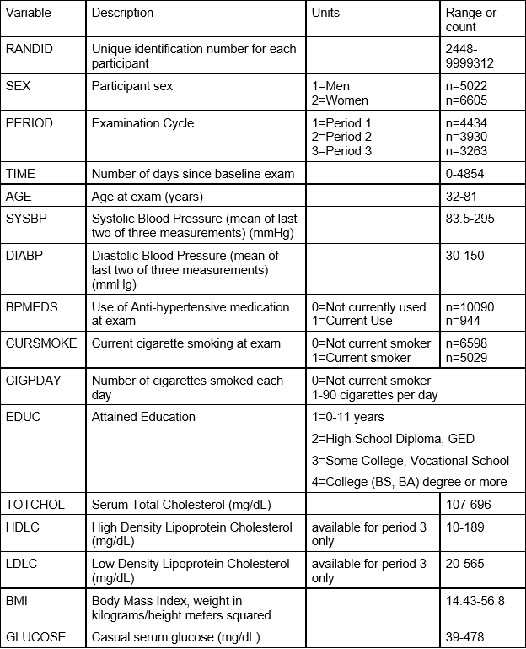
Health Indicators Used

Slide 3
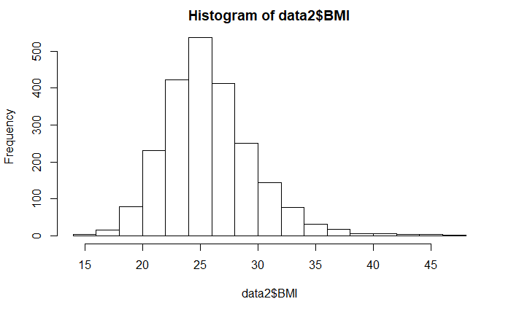
Distribution of the original BMI data

Slide 4
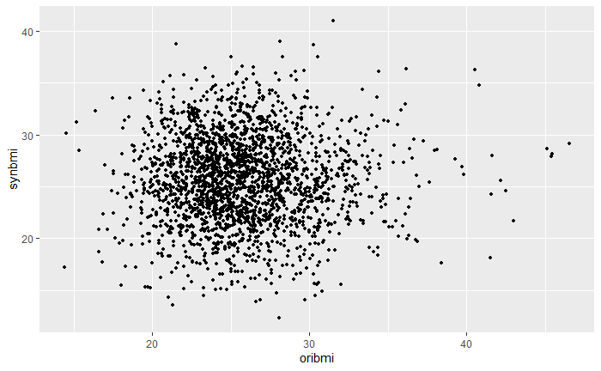
Synthetic model built using the continuous health indicators

Slide 5
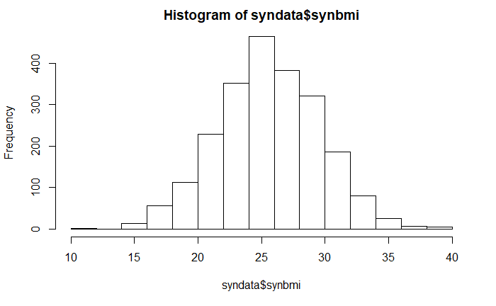
Distribution of synthetic dataset (continuous)

Slide 6
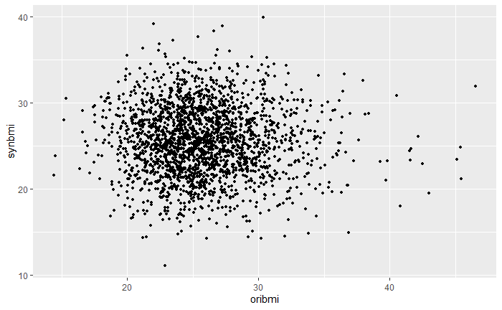
Synthetic model built using the discrete health indicators

Slide 7
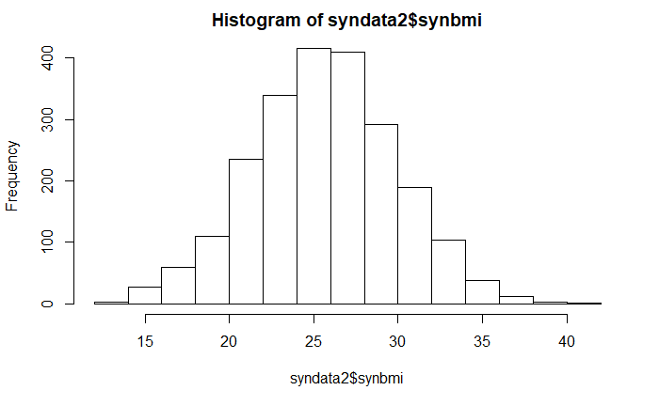
Distribution of synthetic dataset (categorical)

Slide 8
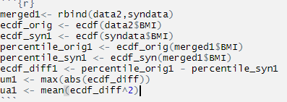
Empirical CDF
Um = .13
Us = .0034

Slide 9
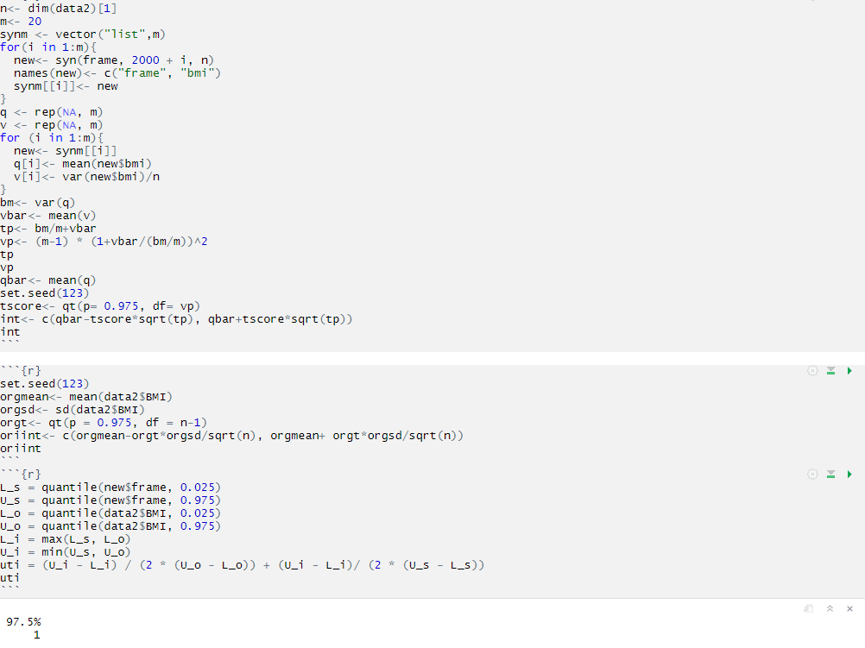
Utility Evaluation

Slide 10
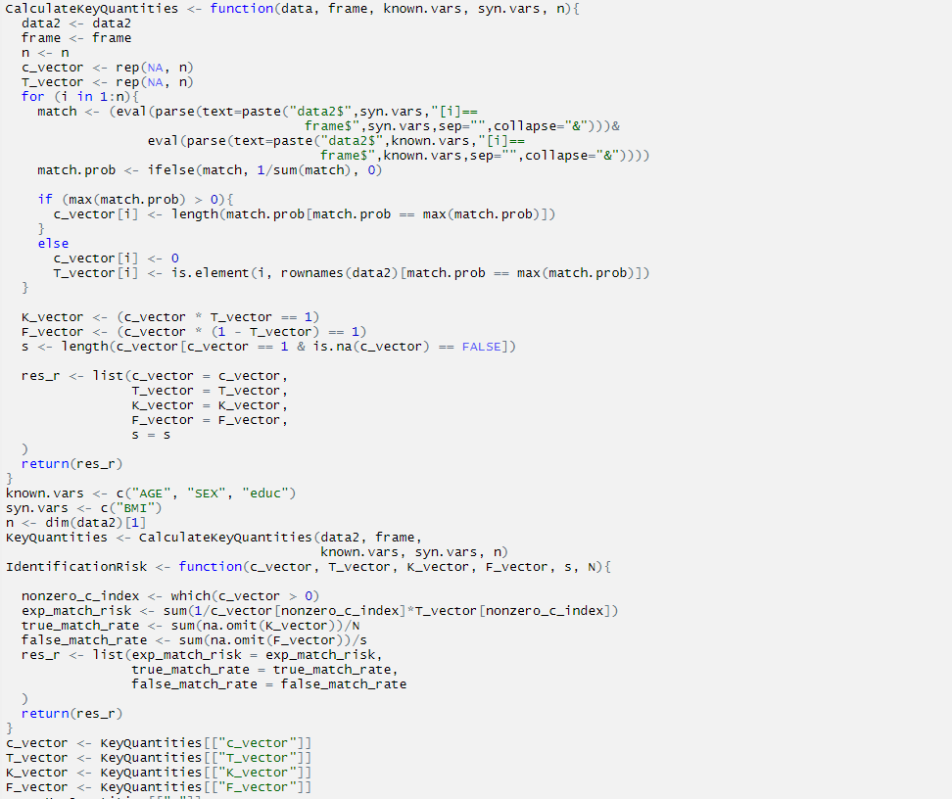
Risk Evaluation

